Slide 1



IMDB
View in Power BI
Last data refresh:
18/02/2020 22:06:19 Central America Standard Time
Downloaded at:
20/02/2020 19:30:12 Central America Standard Time

Slide 2
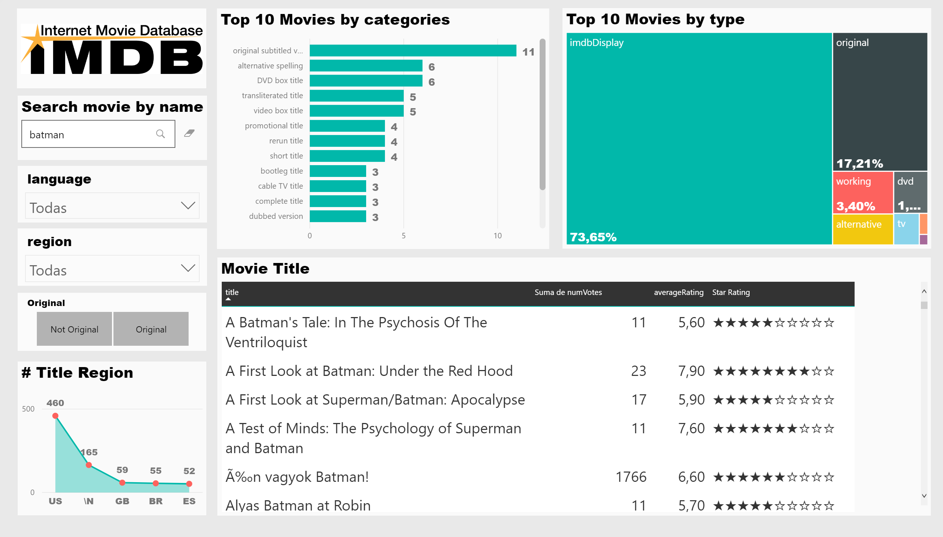

Slide 3
